Slide 1
To Pharmacy Team Members
We hope you can use this slide set as a starting point for making presentations in your community about the importance of vaccinations for COVID-19 and other vaccine-preventable diseases.
Feel free to pick and choose slides that meet your local needs.
There are many slides here to consider for your presentation. You will probably want to use only 5 to 10 slides, depending on your audience. The most important thing for you to do is to make a few points that inspire confidence, rather than make a “data dump.”
Before your presentation, refresh your readiness to respond to questions and criticism with the many perspectives addressed at vaccineconfident.pharmacist.com.

Slide 2
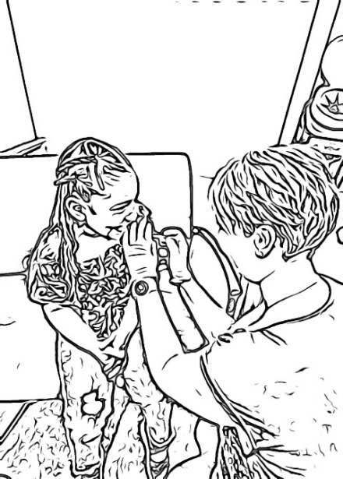
Slide deck to be adapted for community conversations and presentations
Pharmacists strengthening vaccine confidence in their patients and communities.

Slide 3
Slides About Childhood Vaccines in General

Slide 4
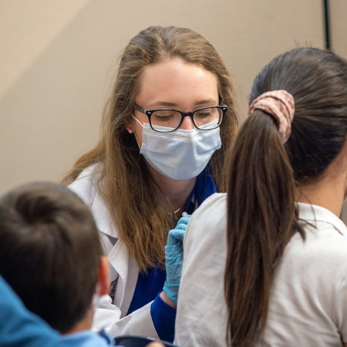
Why Should My Child Get Vaccinated?
COVID-19 can sicken people of all ages. There’s no way to predict how your child might be affected by the COVID-19 virus.
Among children under 18 years old in the United States who’ve gotten COVID-19:
Over 180,000 have been hospitalized
Over 2,000 have died
Even if your child doesn’t get very sick, a COVID-19 infection could still cause health problems down the road.
Your child can also spread the virus to someone who is at risk for severe illness—like a grandparent, a teacher at school, or someone whose immune system is weakened.
COVID-19 vaccines are highly effective at preventing severe illness, hospitalization, and death. Those are the nasty consequences we most want to prevent.
Notes:
Sources:
https://www.cdc.gov/coronavirus/2019-ncov/covid-data/covidview/past-reports/06042021.html
https://www.statista.com/statistics/1191568/reported-deaths-from-covid-by-age-us/
https://www.nytimes.com/interactive/2023/us/covid-cases.html

Slide 5
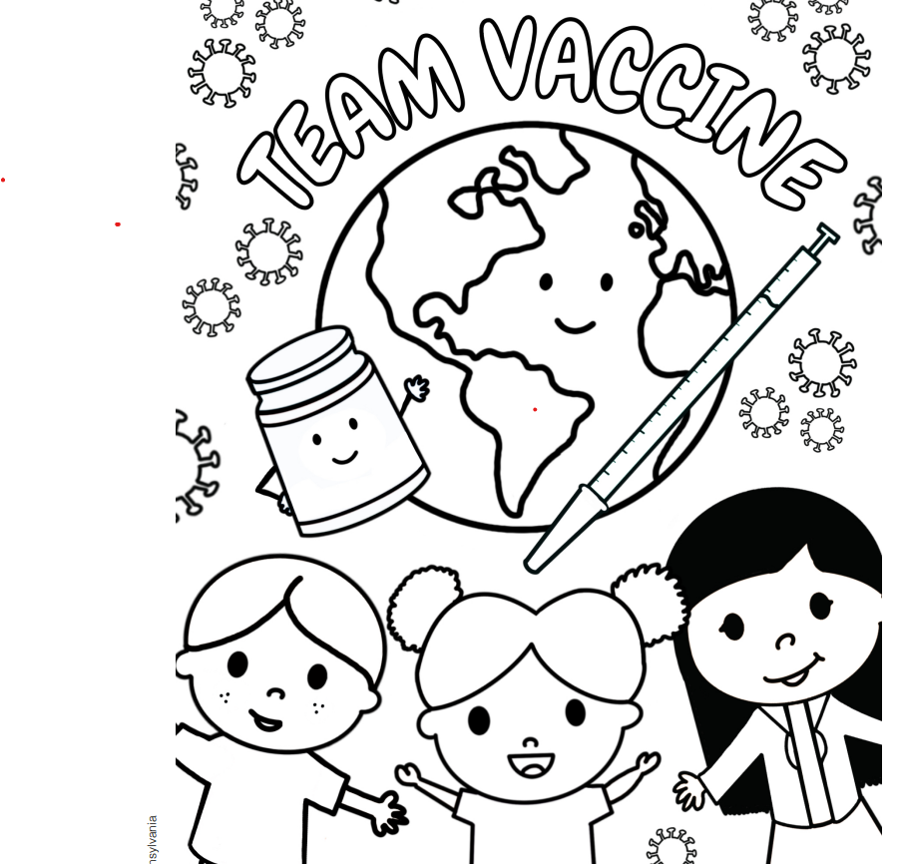
Top 10 Reasons to Vaccinate Your Child
1. Parents want to do all they can to keep children healthy. Vaccines are the best way to do that. 2. Vaccines prevent diseases that can lead to loss of an arm or leg, needing hospital care, pneumonia, hearing loss, convulsions, brain damage, and death. 3. Vaccines can prevent serious diseases like measles, whooping cough, COVID-19, and influenza. These diseases harm U.S. children and lead to hospital care and deaths every year.
4. Some diseases, like measles and rubella, are still common in other countries. A traveler can bring the disease to the United States, or your child can get it while traveling.
5. Disease outbreaks that vaccines can prevent happen when many parents decide not to vaccinate their kids.
Adapted from: https://www.immunize.org/catg.d/p4016.pdf

Slide 6
Top 10 Reasons to Vaccinate Your Child (continued)
6. Vaccines are safe and they work! Scientists and doctors do long and careful reviews of each vaccine to be sure they are safe. 7. Trusted leaders in the American Academy of Pediatrics, the American Academy of Family Physicians, and every children’s hospital all strongly support vaccines to protect kids. And they get their own kids vaccinated! 8. Vaccines protect other people you care about, like family members, friends, and neighbors.
9. If kids aren’t vaccinated, they can spread disease to others. Disease can spread to another child who is too young to be vaccinated. It could spread to a person with a weak immune system from cancer. No one wants to cause these vulnerable people long-term harm or even death.
10. We work together to make our communities stronger. We want to protect each other’s kids. Vaccinating our family members is the best way to protect them and our neighborhoods.
Adapted from: https://www.immunize.org/catg.d/p4016.pdf

Slide 7
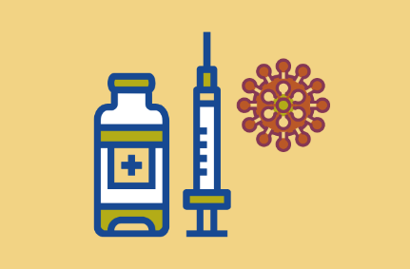
Good News and Bad News
Good News:
More than 20 diseases are vaccine-preventable.
Bad News:
Vaccine uptake is at record low levels (especially since the pandemic).
1 in 4 children are behind on at least 1 vaccination.
Thousands die or are hospitalized each year from diseases that vaccines can prevent.

Slide 8
Slides About Vaccination Across the Lifespan

Slide 9
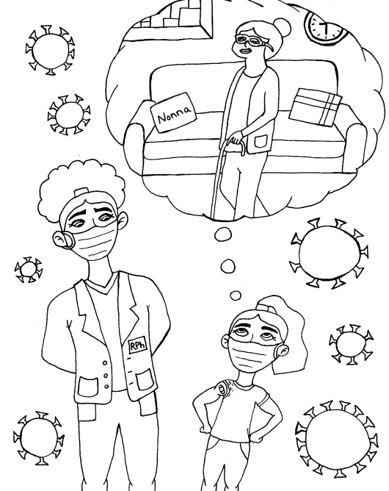
Vaccination = Immunization
Protects children
Protects teenagers
Protects healthy adults
Protects people with chronic diseases
Protects seniors
Protects people of all ages from death, disease, and disability

Slide 10
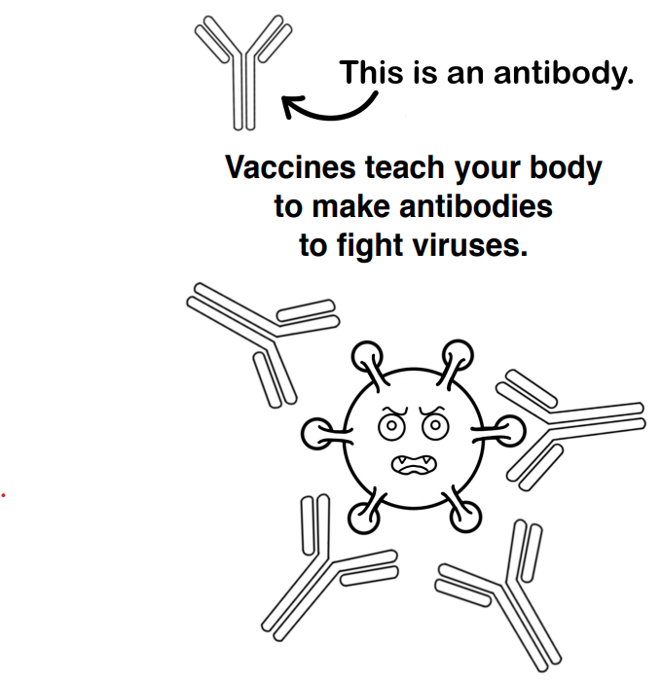
What Is a Vaccine?
A vaccine contains weakened germs or parts of germs.
A vaccine mimics infection, but without disease.
A vaccine causes the body to make antibodies, proteins that destroy viruses or bacteria.
Antibodies develop about 2 weeks after getting a vaccine.
Several doses of vaccine may be needed for immunity.
Immunity may last for months to years.
Booster doses can help restore protection.

Slide 11
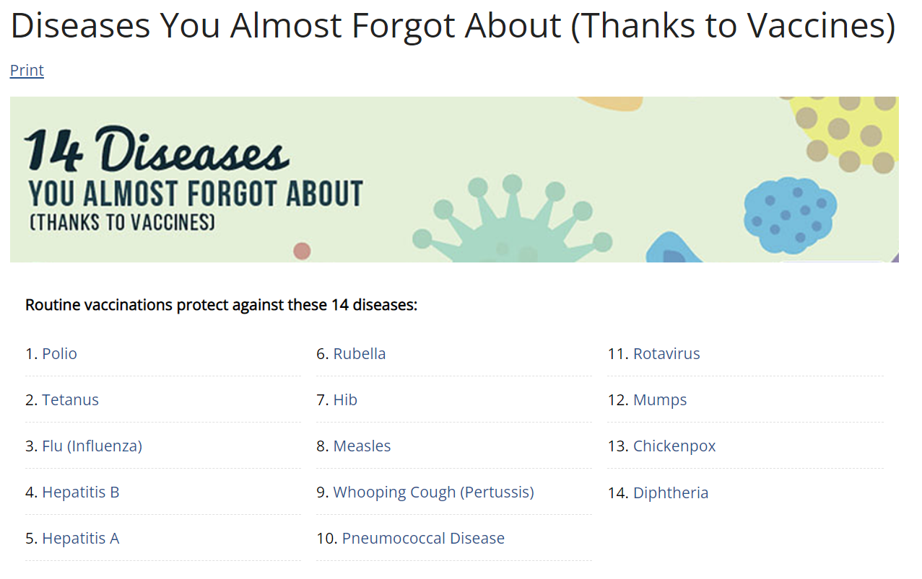
https://www.cdc.gov/vaccines/parents/diseases/forgot-14-diseases.html

Slide 12
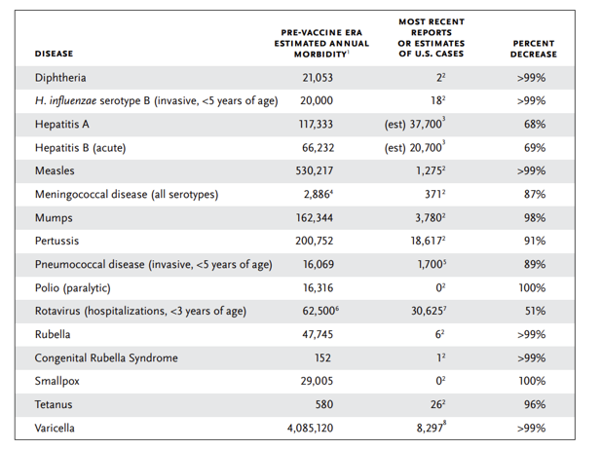
Vaccines Work
Immunize.org https://www.immunize.org/catg.d/p4037.pdf
CDC statistics show big declines in vaccine-preventable diseases compared with the pre-vaccine era.
We still have progress to make with current and evolving diseases.

Slide 13
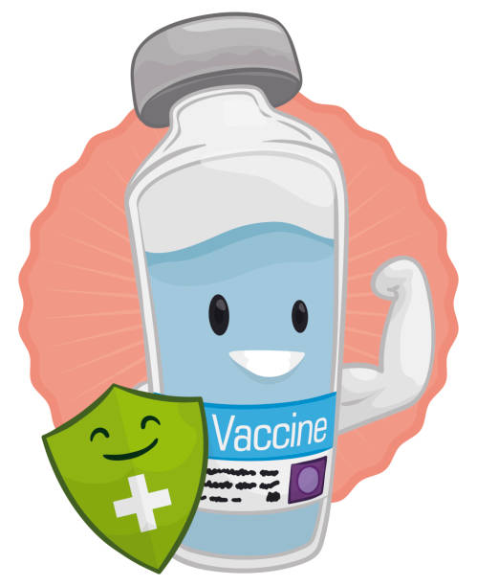
Vaccine Safety
Most vaccines cause mild pain, swelling, and soreness at the injection site. Most people feel better in less than 48 hours.
Live vaccines cause side effects like a mild case of disease (e.g., mild rash).
Most side effects are rarer and milder than the natural disease.
Report any severe side effect that occurs to your doctor or pharmacist.

Slide 14
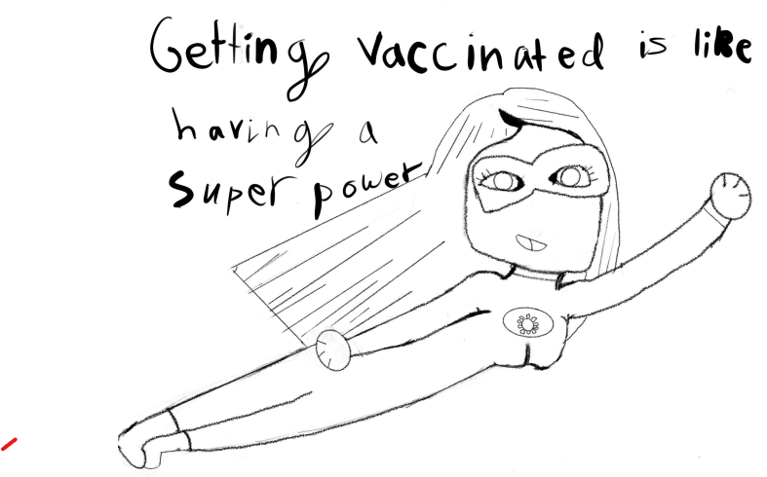
General Recommendations
Take vaccine records to all health visits.
Read vaccine information and decide for
yourself.
Get vaccinated on time.
Get caught up as soon as possible.
You don’t have to start over (your immune system remembers).
Multiple vaccines on the same day are okay.

Slide 15
Slides About COVID-19
Use select slides if need to address a particular question

Slide 16
What Is COVID-19 and Why Is Vaccination So Important?
COVID-19 is an infectious disease.
There’s no way to know how COVID-19 disease will affect you. Most people have a mild case, but it can cause serious illness and death.
COVID-19 disease has killed more than a million people in the United States, making it a leading cause of death.
Some people develop long COVID, where they have symptoms that last for weeks or months.
COVID-19 disease can even cause some people to develop new health conditions.
Getting and staying up to date with your COVID-19 vaccine can reduce the risk that you’ll:
Get seriously ill, need hospital care, or die from COVID-19 disease.
Develop long COVID.
Spread the disease to others, putting their health and lives at risk.

Slide 17
Disease or Vaccine Protection?
All immunity is natural. Our bodies produce immunity via natural processes.
Vaccines not only prevent death, but they also prevent suffering. Although vaccines don’t prevent COVID-19 transmission, they reduce it.
Infected people had some immunity but had to go through the disease to get it.
Statistically, the chance that a healthy person would be okay was much higher, but healthy people still got sick and even died.
Infection-acquired immunity is unpredictable.
In some people, immunity lasts months and in others, only a few weeks, so there is no guarantee of protection.
The vaccine’s protection can also fade with time, but with more predictability.
Booster vaccines may be recommended, providing a lower risk choice than getting infected.

Slide 18
What Is a COVID-19 Vaccine?
A COVID-19 vaccine is a vaccine designed to protect against the COVID-19 virus; the name of the virus is SARS-CoV-2.
The vaccine works by helping/teaching the body’s immune system to recognize and fight the COVID-19 virus if you are exposed to it.
Vaccines do not contain live virus and cannot give you COVID-19 disease.

Slide 19
How Do COVID-19 Vaccines Work?
The COVID-19 vaccines available in the United States introduce your immune system to the spike protein found on the surface of the virus.
Your immune system sees the spike protein as an invading germ and reacts by creating cells that will be ready to identify and attack the virus if you’re exposed to it.
The vaccines don’t contain the COVID-19 virus, so you can’t get COVID-19 disease from them.
Once your immune system sees the spike protein, your body breaks down the vaccine ingredients and gets rid of them.
At no point do the vaccines change or interact with your DNA.

Slide 20
Different Types of COVID-19 Vaccines
There are two main types of COVID-19 vaccines: mRNA and subunits.
mRNA Vaccines:
Pfizer-BioNTech
Moderna
These deliver a small gene segment to cells, like a blueprint, telling them to produce a harmless protein found on the surface of COVID-19 virus. This stimulates an immune response, teaching the body to recognize and fight the virus.
Protein Subunit Vaccines:
Novavax
Contains proteins from spike protein of COVID-19 virus. These proteins stimulate an immune response, preparing the body to defend against the actual virus.
Both types of vaccines contain a piece of the virus that triggers an immune response.
Guidance on their use comes from the FDA and CDC, based on clinical evidence.

Slide 21
Are COVID-19 Vaccines Safe for People Who Want to Become Pregnant, Are Pregnant, or Are Breastfeeding?
Evidence confirms that people who are pregnant or were recently pregnant are at higher risk for severe illness if they get COVID-19 disease.
COVID-19 disease can be a dangerous disease during pregnancy. COVID-19 increases the risk of severe illness in pregnant moms and preterm birth of the baby. It might increase risks for other problems during pregnancy.
Getting a COVID-19 vaccine can protect you against severe illness from COVID-19 and help keep your baby safe.
Evidence shows that vaccination against COVID-19 does not lead to complications during pregnancy.
Evidence shows that COVID-19 vaccines have no effect on fertility, miscarriage, or healthy deliveries.
CDC recommends COVID-19 vaccination for all people who are pregnant, want to become pregnant, or are breastfeeding.

Slide 22
Are There Populations Who Still Need a Primary Series?
Unvaccinated Young Children
While most adults have completed a primary series, most children ages 6 months – 4 years remain unvaccinated.
For most older children, adolescents, and adults, future doses will be an additional “boost” after prior infection, prior vaccination, or both
Young children will continue to age into the vaccine recommendations at 6 months and could be SARS-CoV-2 naïve.
Some populations of young children likely still need a ‘prime’ and ‘boost’ to optimize immunity.
Source: CDC ACIP February 24, 2023

Slide 23
COVID-19 Vaccine Development
Developed in record time but were not “rushed.”
Speediness does not equal carelessness. All the usual steps for testing, evaluation, and review were done properly and thoroughly.
None of the usual steps in the vaccine development process were skipped. Rather, some steps were conducted on an overlapping schedule to gather important data faster.
The vaccine developers did not cut corners—they cut “red tape.” Because the pandemic was a true global emergency, there was a worldwide effort to remove usual bureaucratic hurdles, with governments funding concurrent activities.

Slide 24
COVID-19 Vaccine Development (continued)
The vaccines were reviewed by independent panels of experts and approved under an Emergency Use Authorization (EUA) process set up in the early 2000s, before the COVID-19 pandemic. The EUA process is used only when there is a serious and immediate risk to the public’s health.
Vaccines were authorized for emergency use after extensive clinical testing in tens of thousands of volunteers from many diverse backgrounds, races, ethnicities, ages, and geographic areas.
The vaccines have gone through the same safety tests and meet the same standards as other vaccines produced through the years. And the COVID-19 vaccines continue to be monitored through multiple safety systems.

Slide 25
What Are the Symptoms of Long COVID?
People who have long COVID can experience a variety of symptoms. Commonly reported symptoms include:
Tiredness or fatigue that interferes with daily life.
Fever.
Difficulty breathing or shortness of breath.
Cough.
Chest pain.
Fast-beating or pounding heart (known as heart palpitations).
Difficulty thinking or concentrating (known as “brain fog”).
Headache.
Sleep problems.
Dizziness when you stand up (lightheadedness).
Pins-and-needles feelings.
Change in smell or taste.
Depression or anxiety.
Diarrhea.
Stomach pain.
Joint or muscle pain.
Rash.
Changes in menstrual cycle.
Symptoms that get worse after physical or mental effort (known as “post-exertional malaise”).

Slide 26
Slides About COVID-19 and Children

Slide 27
What Is COVID-19 and Why Vaccinate?
COVID-19 is a disease caused by the SARS-CoV-2 virus. It can cause respiratory symptoms, fever, and other symptoms. In severe cases, it can cause hospitalization and death.
Children can get COVID-19 and can transmit the virus to others, especially people who are vulnerable to the disease.
Vaccinating children against COVID-19 can help protect them from getting sick with COVID-19.
COVID-19 vaccines are highly effective in preventing COVID-19 in children.
Getting vaccinated can help children avoid getting sick, missing school or other activities, and developing long-term health problems.

Slide 28
Key Messages Regarding COVID-19 Vaccination
Protect your children from COVID-19: Vaccinating your kids against COVID-19 is the best way to protect them from getting sick and developing long-term health problems.
COVID-19 vaccines are safe and effective: Studies have shown that COVID-19 vaccines are safe and effective in children and can help reduce the spread of the virus in the community.
Get back to normal: Vaccinating against COVID-19 has helped children return to a more normal way of life, with fewer restrictions and a lower risk of outbreaks.
Protect others: Vaccinating your children against COVID-19 not only protects them, but also helps protect others who cannot get vaccinated, such as people with certain medical conditions or allergies.

Slide 29
Key Messages Regarding COVID-19 Vaccination (continued)
Keep your kids in school: Vaccinating your kids against COVID-19 can help prevent school closures and interruptions to their education, as well as reduce the risk of transmission in schools.
Trust the science: COVID-19 vaccines have been rigorously tested and have undergone extensive safety and efficacy evaluations, including in clinical trials involving thousands of children.
Protect against variants: Vaccinating your children against COVID-19 can help protect them against new and emerging variants of the virus, which may be more contagious or severe than in previous years.
It’s a community effort: Vaccinating your children against COVID-19 is an important step in protecting the health of our community and helping to end the pandemic.

Slide 30
How Do We Know COVID-19 Vaccines Are Safe For Kids?
The COVID-19 vaccine for children has been through rigorous testing and thorough review by the FDA and CDC.
Thousands of children participated in the clinical trials. Among those who received the vaccine, it was shown to be safe and effective at preventing COVID-19.
COVID-19 vaccines are the most closely monitored vaccines in U.S. history. And the FDA and CDC will continue to monitor the safety of COVID-19 vaccines, including among children.

Slide 31
What Are the Risks of Getting Myocarditis or Pericarditis From Receiving an mRNA COVID-19 Vaccine?
Myocarditis and pericarditis are two kinds of heart swelling that can cause symptoms like chest pain, a fast or hard heartbeat, and shortness of breath.
These kinds of heart swelling following COVID-19 vaccination are extremely rare.
When they happen, they mostly happen in teenage boys and young men, typically within several days after mRNA COVID-19 vaccination.
Patients usually recover quickly and respond well to medications and rest.
You’re actually more likely to get heart inflammation if you’re unvaccinated and get sick with COVID-19. And heart inflammation from COVID-19 disease tends to be worse than the heart inflammation people have had after vaccination.

Slide 32
What Are the Common Side Effects From COVID-19 Vaccines?
Children who have received a COVID-19 vaccine get the same common side effects as adults.
Common side effects include:
Pain, redness, or swelling where you got your shot.
Tiredness.
Headache.
Muscle pain.
Chills.
Fever.
Nausea.
These side effects are normal and typically last for a couple of days after vaccination.
These symptoms are signs that the vaccine is working and that your child’s body is building protection against the virus.

Slide 33
If My Child Already Had COVID-19, Is Vaccination Still Needed?
Yes. Children should get vaccinated against COVID-19 even if they’ve already had COVID-19.
Having had COVID-19 doesn’t protect someone against getting infected again.
In fact, a recent study found that unvaccinated people are more than twice as likely to be reinfected with COVID-19 than those who had COVID-19 and then got vaccinated.

Slide 34
What Are the Safety Concerns of COVID-19 Vaccines in Children?
The COVID-19 vaccines have been shown to be safe in children.
Side effects are generally mild and go away on their own within a couple of days.
Serious allergic reactions are rare.

Slide 35
Addressing Vaccine Questions

Slide 36
Do Vaccines Cause Autism?
NO.
Wakefield study (1998) was retracted in 2010 as fraudulent research.
Danish study (Hviid et al., 2019) with more than 650,000 children concluded that MMR was not associated with an increase in autism (used data from siblings that have and have not been vaccinated).
Was a group of 4,729 completely unvaccinated children in study – same results
Data from 904 autistic children found no association between MMR and autism (Uchiyama et al., 2007).
Increased diagnosis of autism (1 in 36 children, CDC, 2020).
Updates in diagnosis criteria capture cases sooner and other neurological conditions now fall under autism spectrum
Inaccurate timing tie between autism diagnosis and vaccination
Hviid et al. Ann Intern Med. 2019;171(5):388.
Uchiyama et al. J Autism Dev Disord. 2007;37(2):210-217.
CDC. Data & Statistics on Autism Spectrum Disorder.

Slide 37
Vaccine Ingredients
Today’s vaccines use only the ingredients they need to be as safe and effective as possible. A vaccine could include any of these kinds of ingredients:
Adjuvants such as aluminum salts help boost the body’s response to vaccination. Aluminum is also present in antacids, antiperspirants, and other consumer products.
Stabilizers such as sugars or gelatin help keep a vaccine effective after it is manufactured. (Naturally present in the body and found in foods such as Jell-O.)
Formaldehyde helps prevent bacterial contamination during some vaccine manufacturing. Formaldehyde is naturally present in the body at levels higher than in vaccines. It is also found in the environment, preservatives, and household products.
Thimerosal is a preservative used during some vaccine manufacturing. It is no longer contained in any vaccine except multi-dose vials of the flu vaccine. Single-dose vials of flu vaccine contain no thimerosal.
Some websites may claim that ingredients are harmful; make sure you seek information from credible sources.

Slide 38
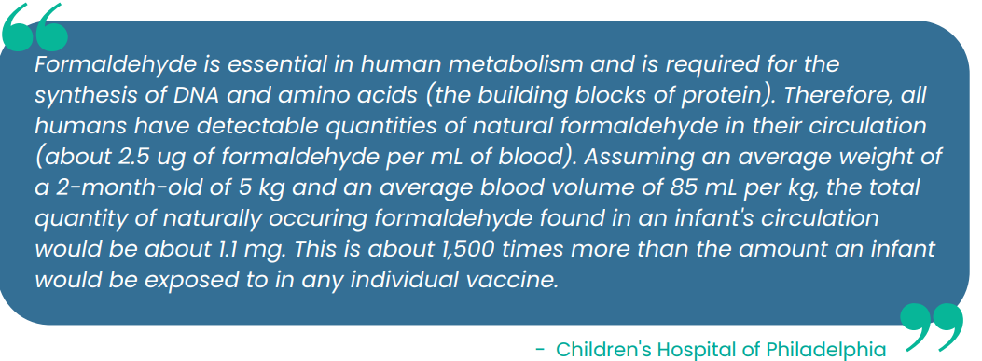
Is Formaldehyde, an Ingredient in Some Vaccines, Dangerous?
https://www.chop.edu/centers-programs/vaccine-education-center/vaccine-ingredients/formaldehyde

Slide 39
Is Mercury in Vaccines? Is it Dangerous?
“Mercury” was removed from most childhood vaccines over 20 years ago!
So how many vaccines still contain mercury?
While none actually contain “mercury,” multi-dose flu vaccine vials do contain thimerosal, a preservative that contains an ethylmercury group.
Heavy metal mercury breaks down into methylmercury (not the same).
Methylmercury found in fish (why FDA says limit intake of some fish).
Thimerosal is NOT mercury!
Thimerosal is found in cosmetics, tattoo ink, eye drops and contact lens solution, disinfectants, and products to treat contact dermatitis.
If you don’t want to deal with a small amount of ethylmercury in flu shots, ask for a thimerosal-free flu shot from a pre-filled syringe, which is how over 90% of flu vaccines are now made.

Slide 40
What Is in COVID-19 Vaccine?

Slide 41
Addressing Religious Concerns Regarding COVID-19 Vaccine
Judaism expects its believers to be proactive in maintaining health. Pikuach nefesh, acting to save a life, is a positive commandment overarching even laws for keeping the Sabbath. With contagious diseases, one’s own actions help or hinder transmitting the illness to bystanders. Jewish dietary laws (“keeping kosher”) apply to foods, not medications. COVID-19 vaccines do not contain components of porcine origin, and all COVID-19 vaccines are given by injection.
Islam espouses principles of preventing harm (izalat al dharar yuzaal) and serving the public interest (maslahat al-ummah), each of which favors vaccination. The Qur'ān forbids the consumption of several animals (e.g., “the flesh of swine”). COVID-19 vaccines do not contain components of porcine origin, and medications are given special status within Islam.
Most Christian denominations have no scriptural or doctrinal objection to vaccination per se. Denominations that rely on faith healing (e.g., Christian Scientists, several small sects) may view vaccination as unnecessary or even suggesting unfaithfulness to God’s will. With contagious diseases, one’s own actions help or hinder transmitting the illness to bystanders. Pope Francis recorded a video for Catholics across the Americas in 2021 to encourage COVID-19 vaccination.
Christians, Muslims, and others may express concern over vaccines manufactured using cell lines (e.g., HEK293, PER.C6) with remote links to specific fetuses aborted several decades ago (e.g., viral-vector COVID-19 vaccines from Johnson & Johnson/Janssen). Those abortions were not conducted to create these cell lines. This lack of intent breaks a complicity link that could otherwise make vaccination unacceptable. Messenger RNA in vaccines produced by Pfizer-BioNTech and Moderna and protein subunit vaccines produced by Novavax are chemically synthesized, not grown in cell culture. There are no human cells present in the vaccines. Several faith-based groups have put out statements saying the net good from COVID-19 vaccines outweighs concerns about fetal cell lines.
Cell lines of fetal origin are not the same as fetal tissue. No COVID-19 vaccine contains any tissue from an aborted fetus.

Slide 42
For More Information
Centers for Disease Control. Myths and Facts about COVID-19 Vaccines. https://www.cdc.gov/coronavirus/2019-ncov/vaccines/facts.html
Centers for Disease Control. Communication and Print Resources: Vaccines, Viral and Bacterial Diseases. https://www.cdc.gov/vaccines/communication-resources.html?Sort=Date%3A%3Adesc&Topics=COVID-19

